Slide 1
Customer Call List
Data Cleaning Project

Slide 2
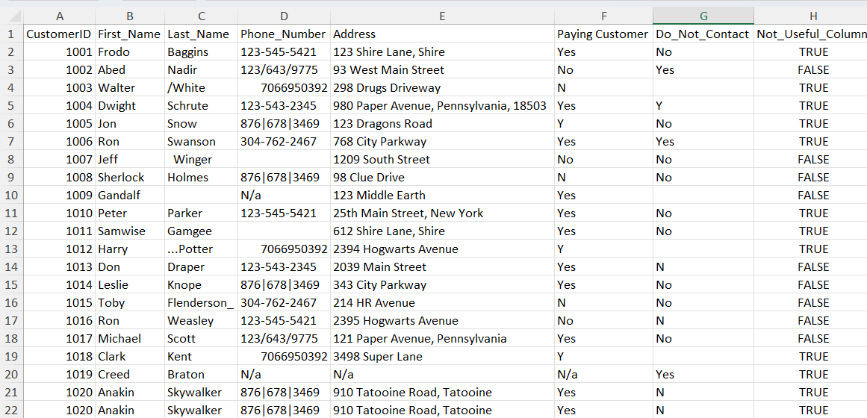
Row Data

Slide 3
objective
Filter Contactable Customers:
Exclude Non-Contactable Records: We will focus on customers who have a "No" in the "Don’t Contact" column. This will ensure we are only working with individuals who are eligible for contact.
Ensure Valid Phone Numbers: Records must have a non-null phone number to be retained. This step is crucial to avoid attempting to contact customers without valid phone numbers.
Clean and Standardize Data:
Standardize Contact Information: Review and standardize the format of phone numbers to ensure consistency across the dataset. This might involve removing formatting characters or standardizing international codes.
Remove Unnecessary Columns: Identify and eliminate columns that do not contribute to the objective of customer outreach, streamlining the dataset for more efficient use.
By focusing on these objectives, we aim to create a targeted, clean dataset that enhances our ability to reach out to customers effectively and efficiently.

Slide 4
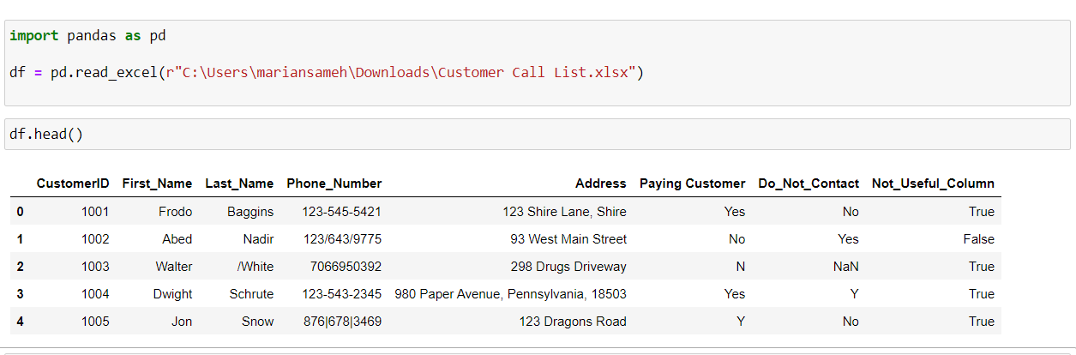
Load the Data

Slide 5
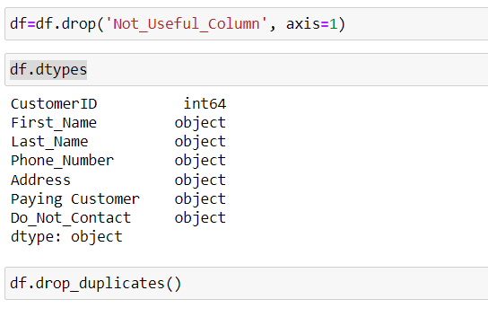
Check data types

Slide 6

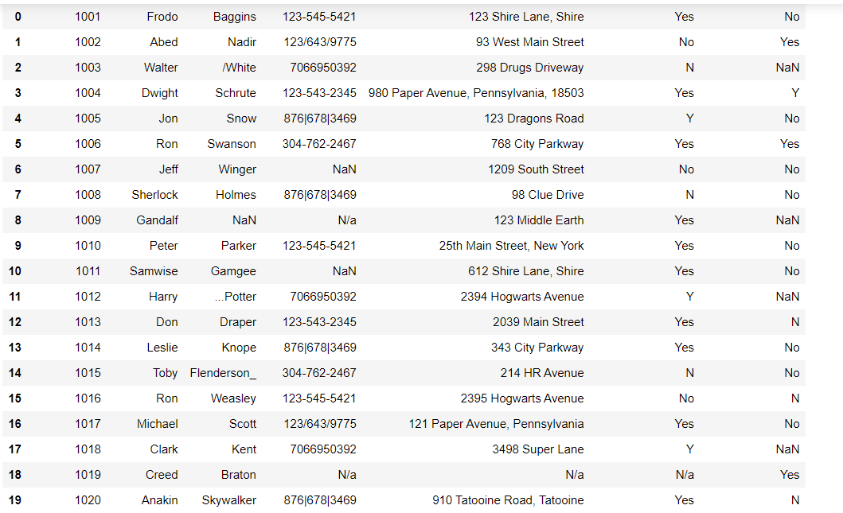
Remove unnecessary data
duplicate row was identified and removed, reducing the row count from 20 to 19

Slide 7
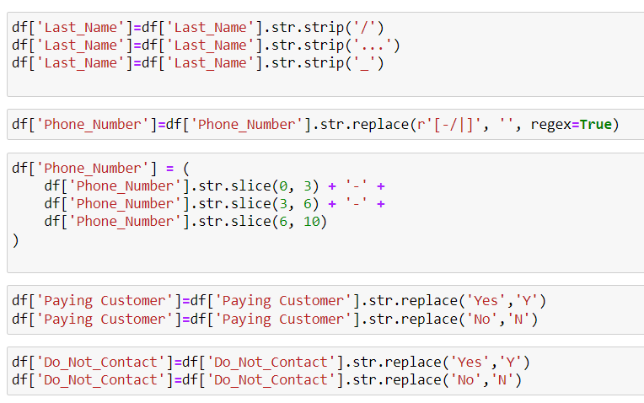
Standardize Data
Removed or replaced special characters in the Last Name column to ensure consistency and correctness.
Standardized phone numbers to a consistent format (XXX-XXX-XXXX).
Standardized the values in the Paying Customer column to Yes or No.
Standardized the values in the Do Not Contact column to Yes or No.

Slide 8
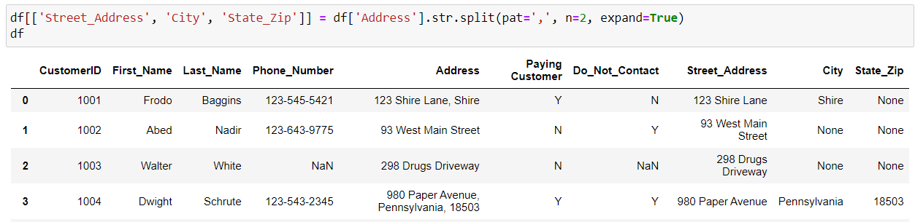
Address Splitting
By splitting the Address column into Street_Address, City, and State_Zip, the dataset is now more granular

Slide 9

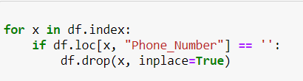
Handle null values & drop rows with no phone number

Slide 10
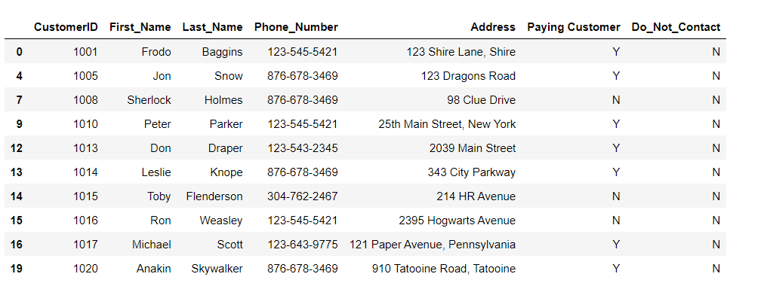
Index problem
During the data cleaning process, the original index was lost, leading to an unstructured or inconsistent index.

Slide 11
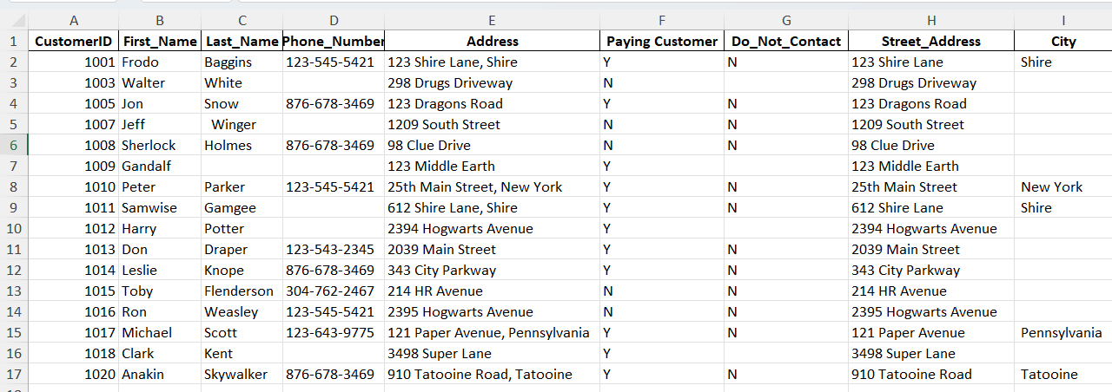
Reset index & Save the cleaned data into an excel file
Final result

